Slide 1



OpenVirus and Plants
FlashForward, Virtual, 2021-02-25
Part 1 1200 UTC: openVirus and CEVOpen.
A community of young Indian scientists show why and how to mine the scholarly literature. Ambreen Hamadani, Ayush Garg, , Kanishka Parashar, Radhu Ladani, Shweata Hegde, Talha Hasan, Vasant Kumar, Dheeraj Kumar
Part 2 1300 UTC: Aroma! the game. We have agreed to run a fun hackday about Gita Yadav’s plant science research for her (non-science) colleagues (in 2021-05) We have 200,000 open articles on PLANTS, their COUNTRY, and their CHEMICALs. Can we make a game (collaborative? Competitive? Team?) where players collect papers
NOTE: These will run sequentially; but Part 2 can be taken alone
ContentMine

Slide 2

Cambridge Botanic Garden in the Viral Pandemic
Plants are the biggest
chemical factory in the world!
Pine
Cedar
Fir
Pinene
Cedrene
Thujene
CC 0 own work PMR

Slide 3
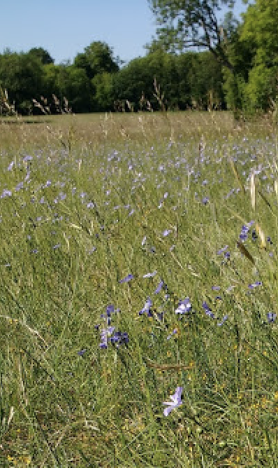
PMR Timeline ☺ and FlashGrants
1975 develops data mining for crystallographic literature.
2010,11 Sponsors 5 Panton Fellowships (OKFN and OSF)
2011 Applies to Shuttleworth. Unsuccessful
2014 Re-applies to SF; Successful. Can nominate 2 FGs/year
2014 Create ContentMine (UK non-profit) PMR + Gita Yadav online
2015 runs ContentMine Fellowships (6 ppl)
2017 ContentMine sponsored by Wikimedia (WikiFactMine)
2019 Cambridge-India TIG2RESS workshop on Plants Delhi (w. Gita Yadav NIPGR)
2019 GY and Manny Faria (Verriclear) on EssoilDB
2019 OpenScience with Simon Worthington TiB on Open Climate Knowledge
2020 NIPGR and INYAS (GY, PMR) start intern program OpenVirus
2021 NIPGR (GY, PMR) intern program CEVOpen (plants, essential oils)
NIPGR National Institute for Plant Genome Research, New Delhi IN
TiB German National Science Library DE
INYAS Indian National Young Academy of Scientists
OKFN Open Knowledge Foundation
OSF Open Society Foundations
Linaria (English Flax)

Slide 4

Part1 OpenVirus and CEVOpen
Mining scholarly literature for hidden science:
download papers
read text
analyze
Easy!? Oh no it isn’t…
Salix -> salicylic acid

Slide 5
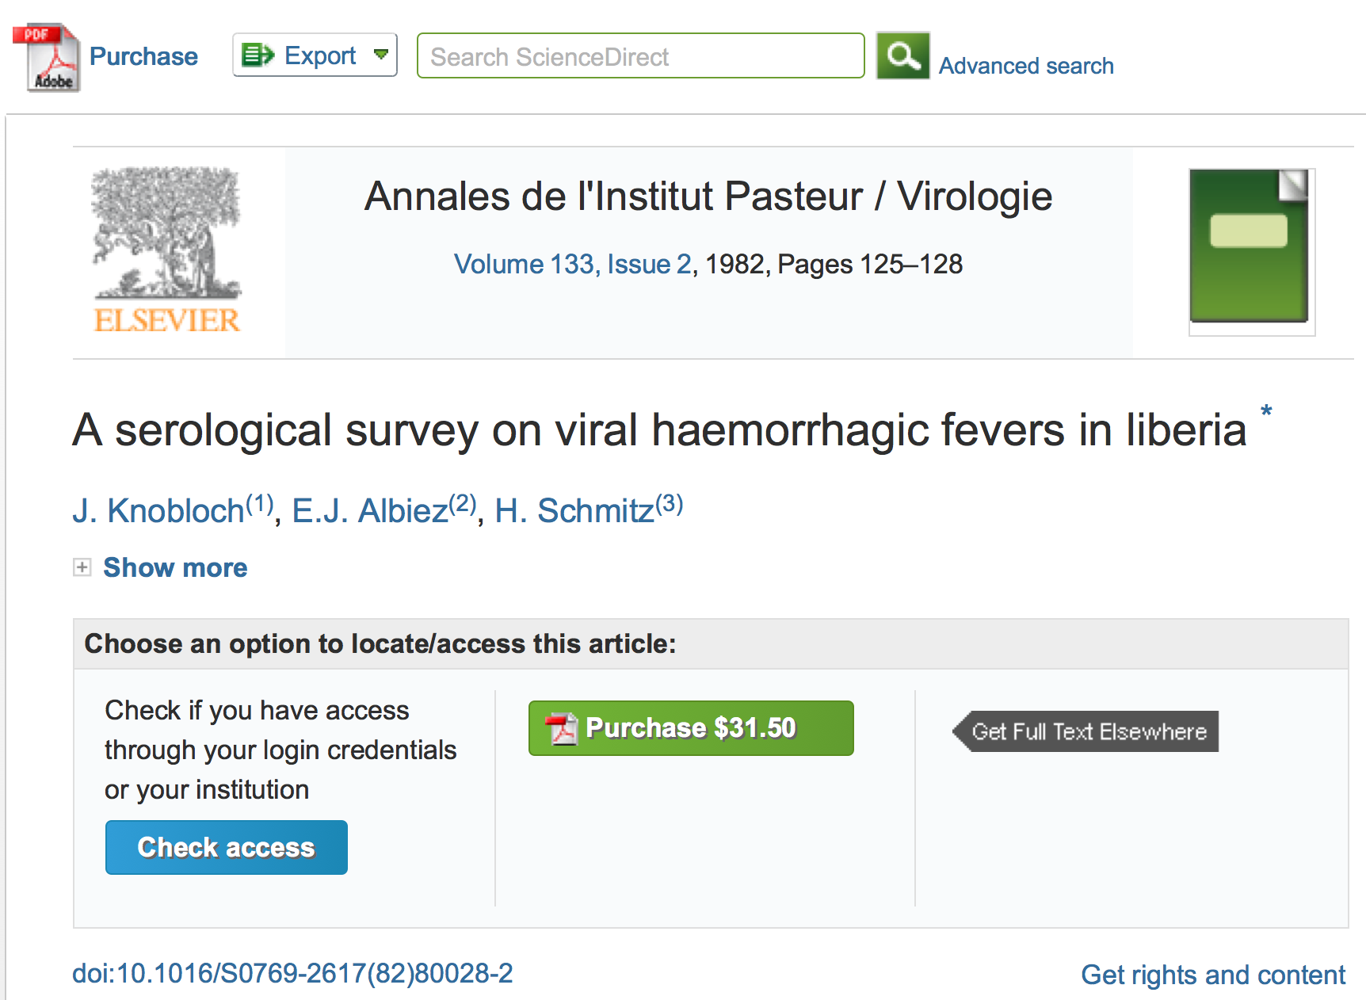
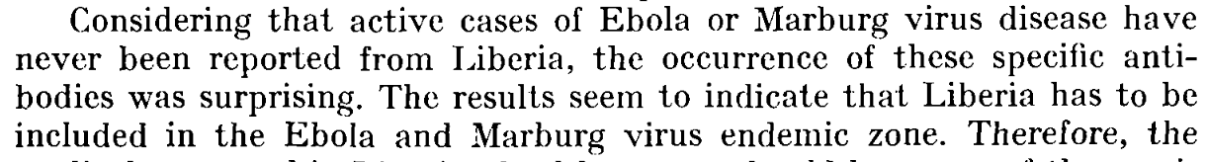

Slide 7
A System Failure of Scholarly Publishing
http://www.nytimes.com/2015/04/08/opinion/yes-we-were-warned-about-ebola.html
We were stunned recently when we stumbled across an article by European researchers in Annals of Virology [1982]: “The results seem to indicate that Liberia has to be included in the Ebola virus endemic zone.” In the future, the authors asserted, “medical personnel in Liberian health centers should be aware of the possibility that they may come across active cases and thus be prepared to avoid nosocomial epidemics,” referring to hospital-acquired infection.
Bernice Dahn (chief medical officer of Liberia’s Ministry of Health)
Vera Mussah (director of county health services)
Cameron Nutt (Ebola response adviser to Partners in Health)

Slide 8
Lantana camara in Cambridge University Botanic Garden

Slide 9
… Shweata Hegde is now narrator ..

Slide 10
Part2 Aroma! The game

Slide 11
Part2 Aroma! The game
Aroma! the game. We have agreed to run a fun hackday about Gita Yadav’s plant science research for her (non-science) colleagues (in 2021-05) We have 200,000 open articles on PLANTS, their COUNTRY, and their CHEMICALs. Can we make a game (collaborative? Competitive? Team?) where players collect papers
NOTE: These will run sequentially; but Part 2 can be taken alone

Slide 12
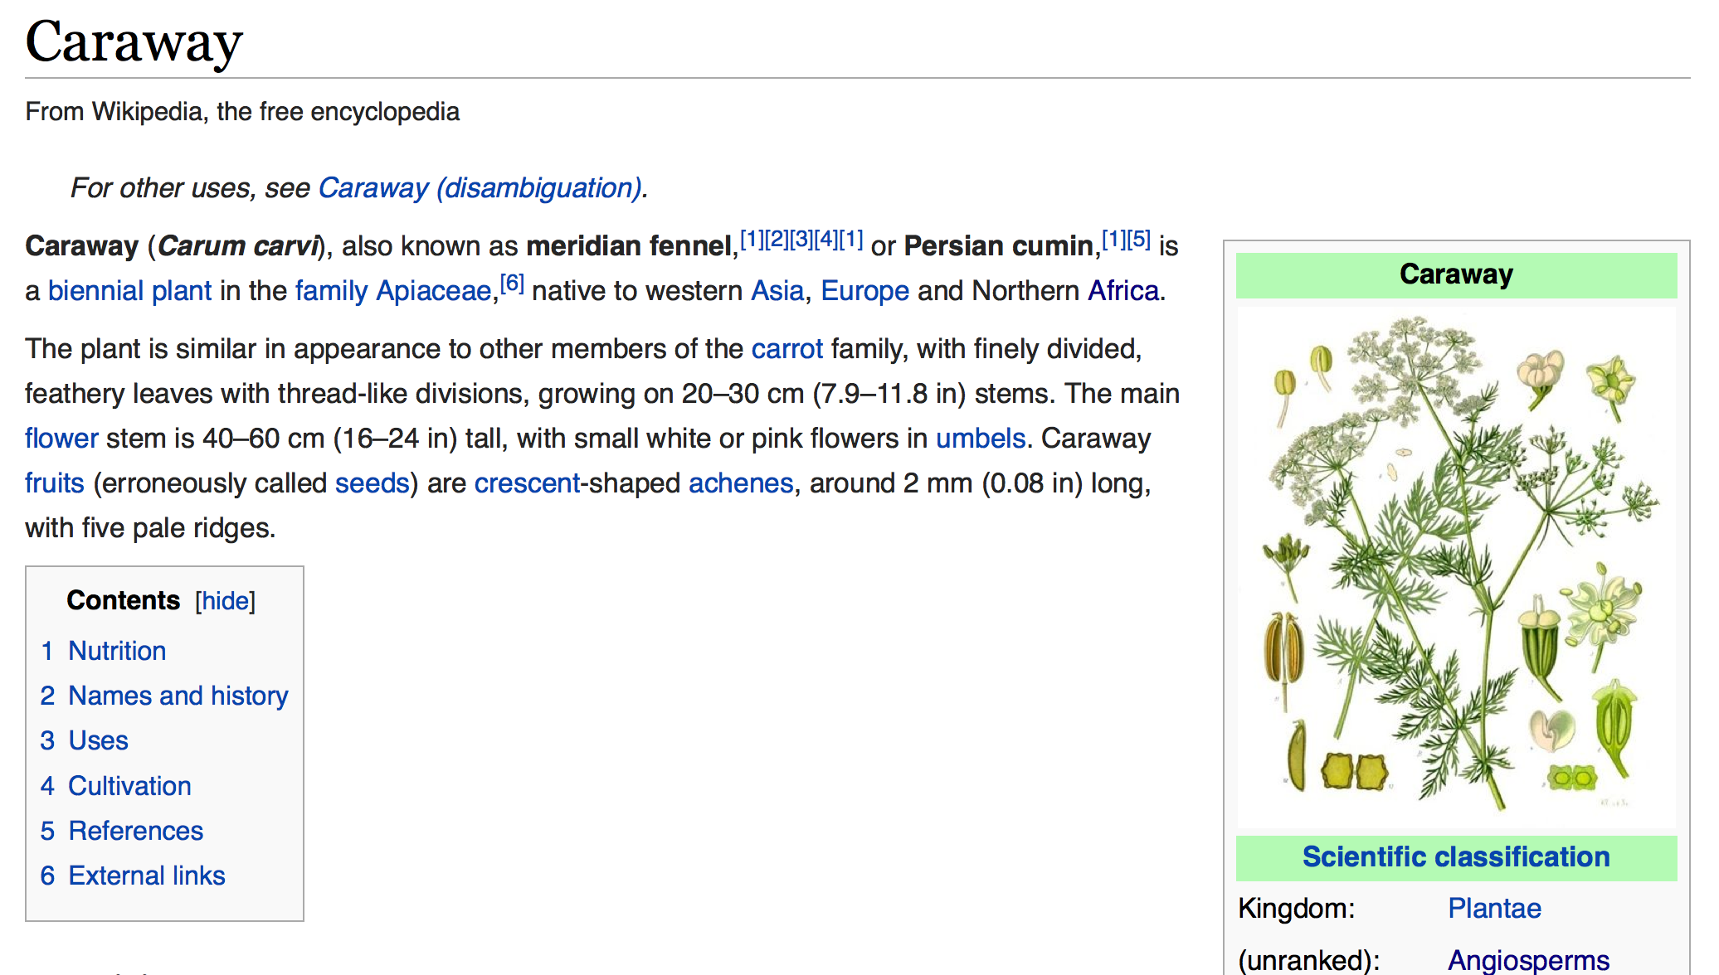
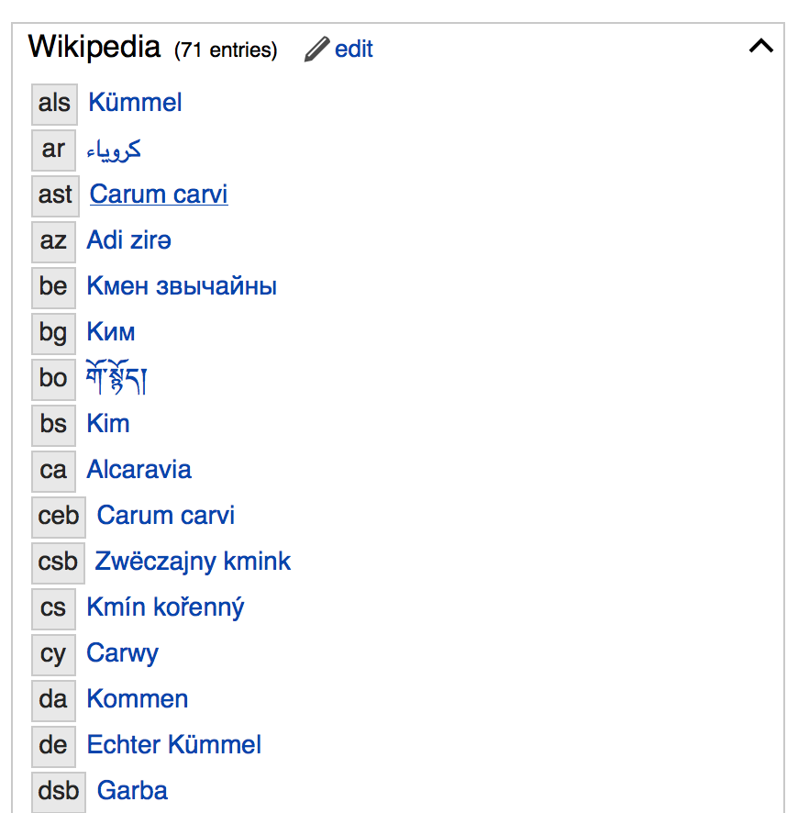
https://en.wikipedia.org/wiki/Carvone
WIKIDATA

Slide 13
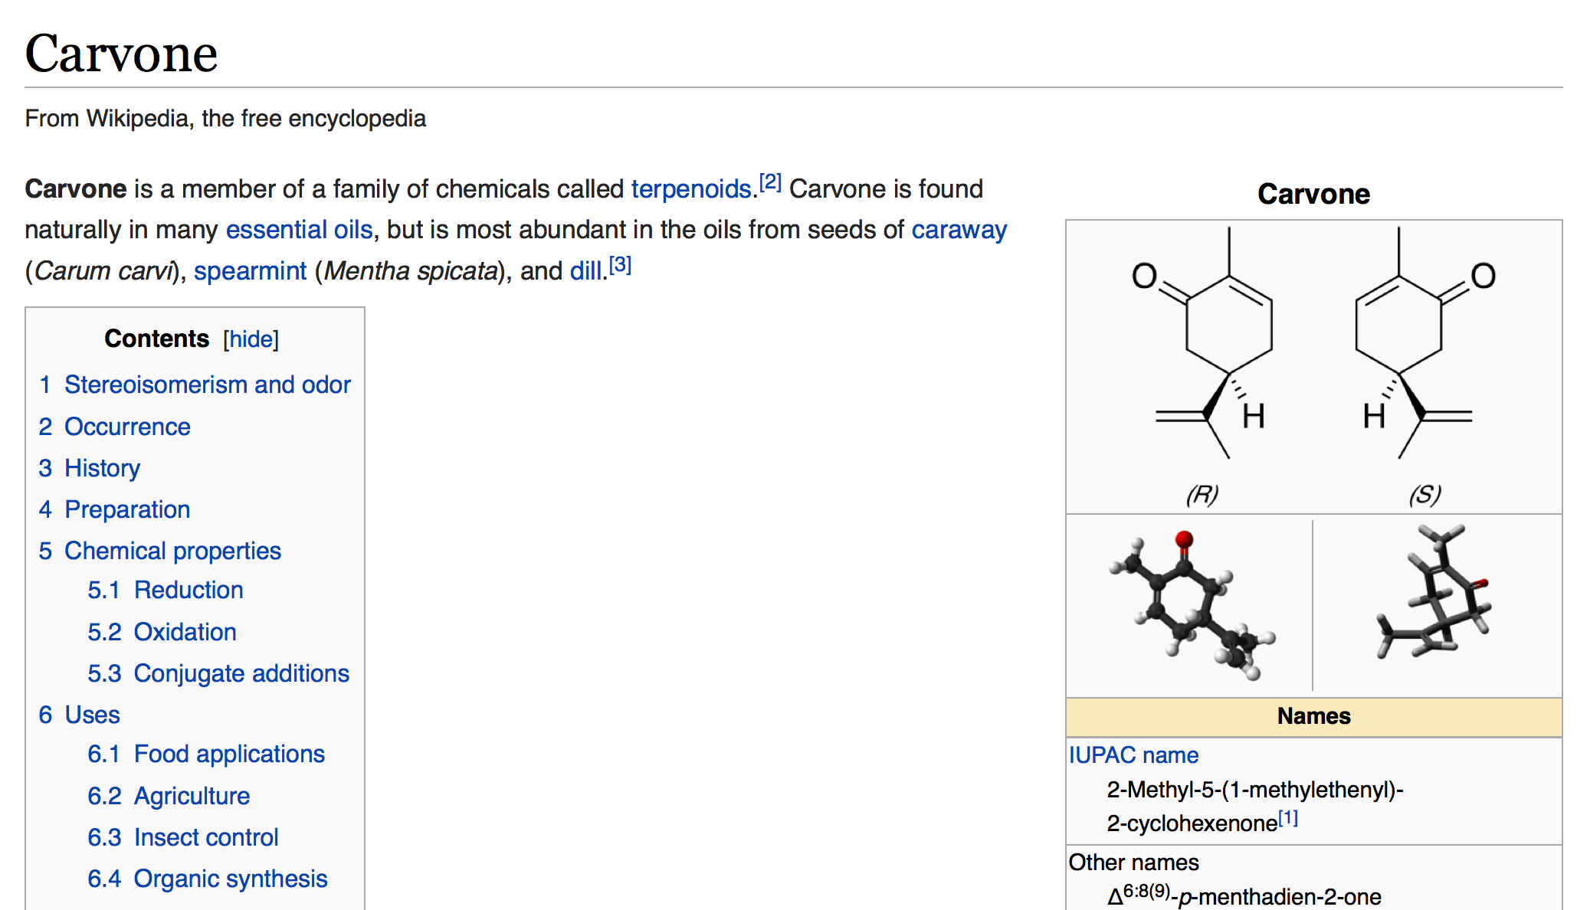
What plants produce Carvone?
https://en.wikipedia.org/wiki/Carvone
https://en.wikipedia.org/wiki/Carvone

Slide 14
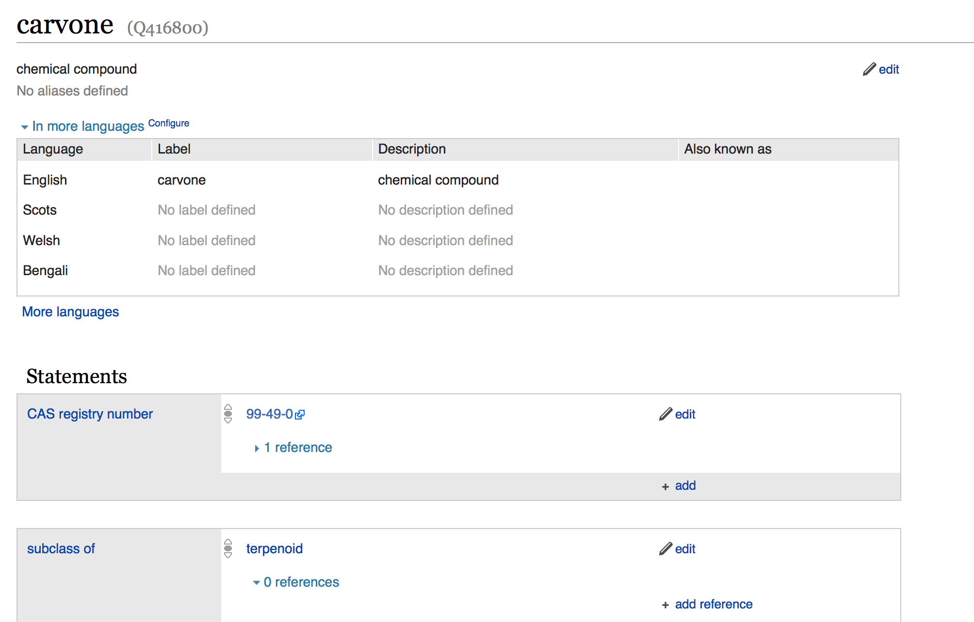
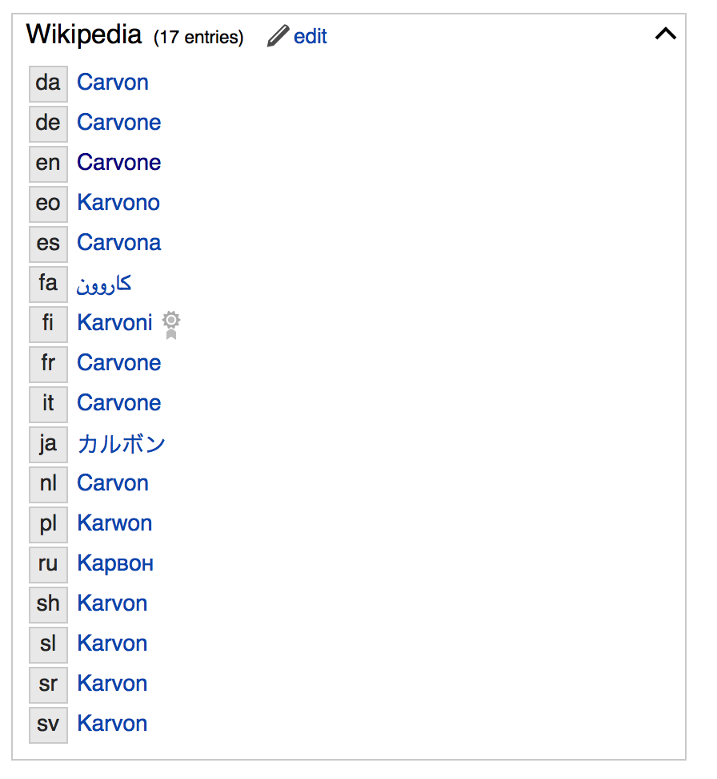
Carvone in Wikidata
Also SPARQL endpoint

Slide 15
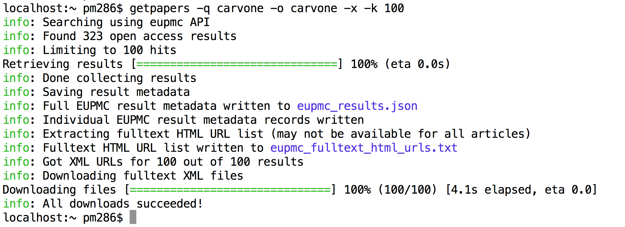
Search for carvone

Slide 16
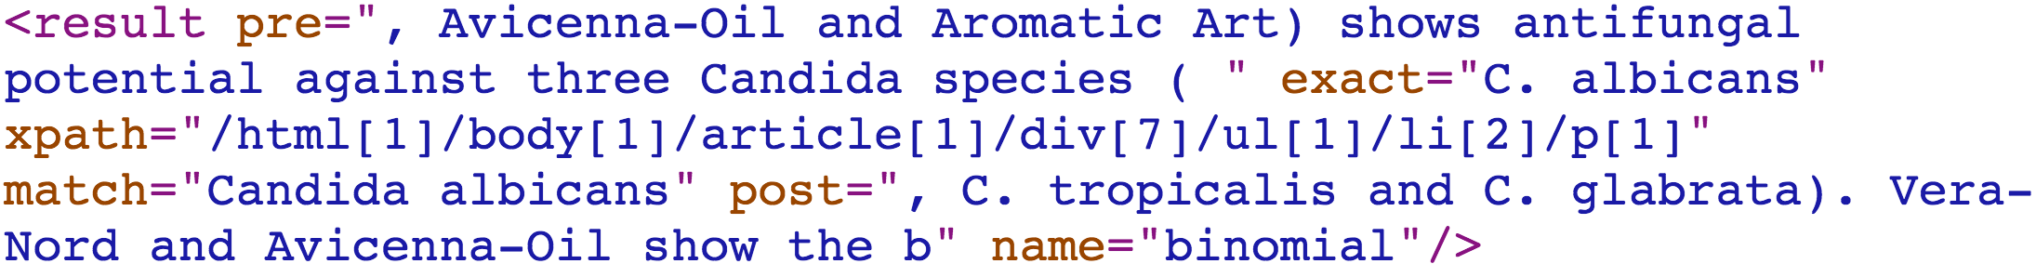
Annotation (entity in context)
prefix
surface
location
suffix
label

Slide 17
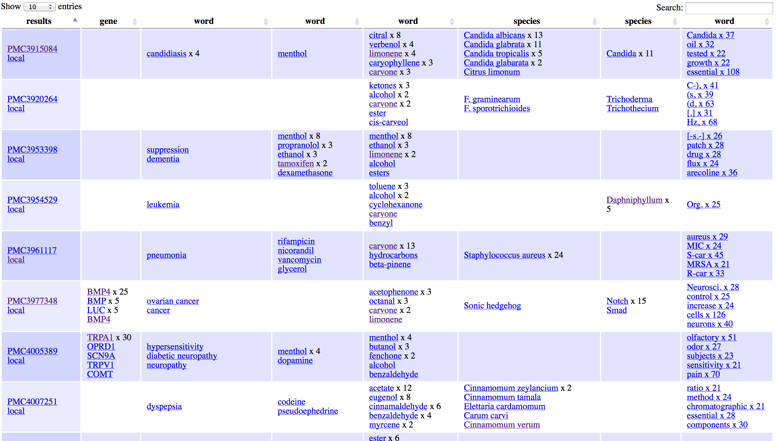
ARTICLES
FACETS
gene
disease
drug
Phyto
chem
species
genus
words

Slide 18
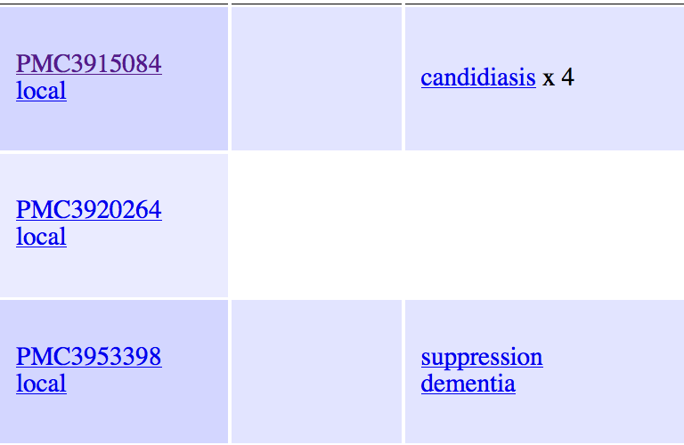
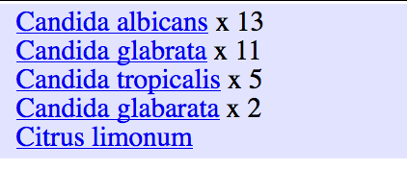
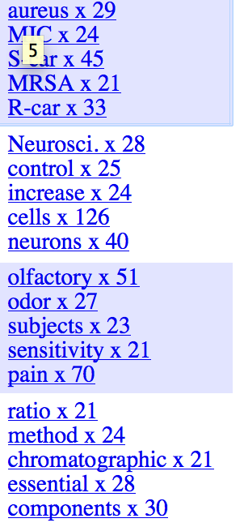
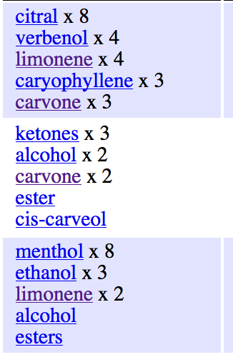
Remote &
Local papers
Disease
ICD-10
species
Commonest
words
phytochemicals

